Slide 1
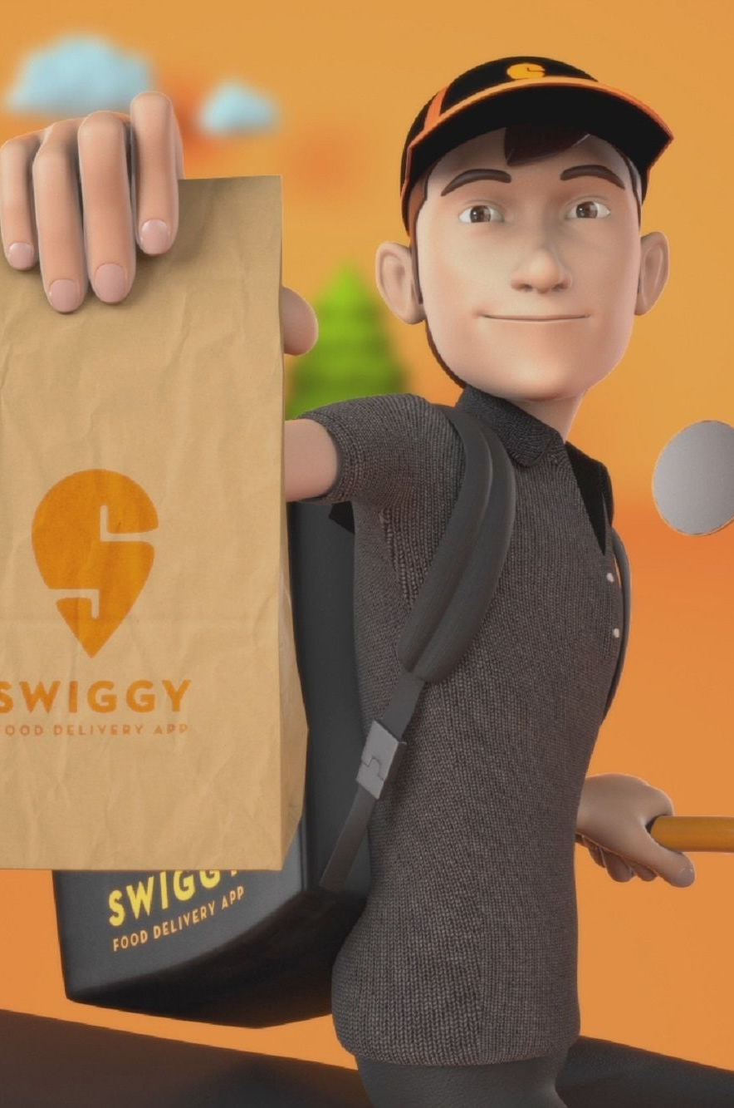

FSSAI Escalation Insights: Exploring Trends and Factors Impacting Swiggy Deliveries
An Analysis of the Data and Recommendations for Improvement.

Slide 2
Problem Statement
Problem: FSSAI issues social media escalations for Swiggy deliveries have increased in July
as opposed to previous months, with a significant increase during late night and dinner time slots.
Types of FSSAI Issues
Veg-Non Veg contamination
Contaminated food (e.g., insect found in food)
Bad quality food (smelly food, rotten food)
Expired items

Slide 3
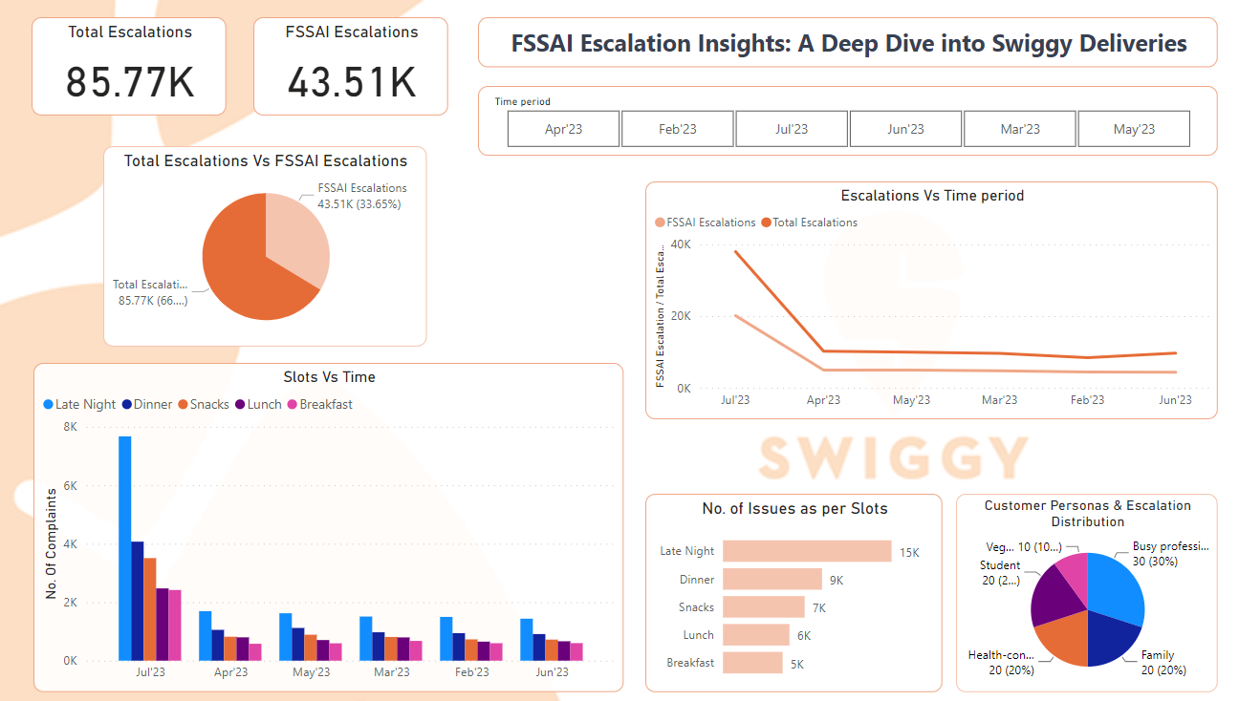
Key insights from the data
The number of FSSAI issues per million orders
is highest for late night deliveries, followed by
dinner, snacks, lunch and breakfast.
The types of FSSAI issues that are most common during late night deliveries are contaminated food and bad quality food.
The sudden spike in July and the consistent high escalation rates during late-night and dinner slots could warrant deeper investigation.
Exploring external factors or events during these periods might provide insights into the escalations.
Tool Used: Power BI

Slide 4
Customer Personas and Escalations
Customer | Proportion of escalations | Type of escalation | Sample voice of customer
Busy professional | 30% | Queries | "I ordered food for delivery but it arrived late. I was really hungry and I was worried about the food being cold."
Student | 20% | Requests | "I ordered food for delivery but it was the wrong order. I called customer service but they were unable to help me."
Family | 20% | Complaints | "I ordered food for delivery for my family but it was contaminated. My kids got sick and I had to take them to the doctor."
Health-conscious | 20% | Queries | "I ordered food for delivery but I was concerned about the nutritional value of the food. I called customer service but they were unable to provide me with any information."
Vegan/vegetarian | 10% | Requests | "I ordered food for delivery but it contained meat. I called customer service but they were unable to offer me a refund."
Swiggy may need to focus on providing better customer service to busy professionals, who are more likely to escalate issues related to late deliveries.
Swiggy may also need to work on improving the accuracy of its orders, as students are more likely to escalate issues related to wrong orders.
Swiggy may also need to provide more information about the nutritional value of its food to health-conscious customers.
Swiggy may also need to offer refunds to vegan/vegetarian customers who receive orders that contain meat.

Slide 5

Hypotheses for the increase in
FSSAI issues
1
Environmental Factors 🌦
Weather conditions, traffic and other environmental factors may affect the quality of the food during delivery.
2
Restaurant-Related Factors 🍔
The quality of the food may be affected by the restaurant's food handling practices and hygienic standards.

Slide 6


Recommendations for improvement
Swiggy should investigate the reasons for the increase in FSSAI issues during late night deliveries and take steps to address them.
Strengthen supplier collaboration through audits, quality checks and consistent adherence to standards to minimize contamination and expired item risks
Swiggy should implement measures to improve customer satisfaction during late night and dinner time slots, such as:
Providing more training to delivery personnel on food safety and handling procedures.
Working with restaurants to ensure that food is prepared and handled hygienically during late night hours.
Offering incentives to restaurants that maintain high standards of food safety during late night hours.
Creating a dedicated customer service line for late night deliveries.
Adopt a persona-centric approach, prioritizing the Complaints persona for their higher criticality and sensitivity, while implementing tailored solutions to address diverse customer concerns.

Slide 7

Conclusion
The increase in FSSAI issues during late night deliveries is a serious concern for Swiggy. Swiggy should take steps to address this issue and improve customer satisfaction. The recommendations outlined in this presentation can help Swiggy to achieve these goals.
Thank You

